Slide 1

Project 3
Salesforce Solution for 'Tours for life'
Thabit Hamror
March 2022

Slide 2
Overview
My role:
Salesforce admin
The project:
To implement a solution for a bus travel company in France 'Tours for Life'
The goal:
To meet needs of managers and sales reps in managing prospects, travelers and bookings

Slide 3



Who are my clients?
Field
Individuals
Companies
Fare type
Part of Booking object
Part of Trip object
Traveler's name
Person name
Company name
Solution for individual clients require additional customization

Slide 4
Roles & Profiles
Requirement | Solution | Support
3 Roles | 1 Sales Manager 2 Sales Reps (North & South) | A role takes any number of users Sales reps can see own data only Sales managers can see all
1 - 2 Profiles | Salesforce standard Salesforce platform System Administrator | Standard license required if more than 2 users (including Admin); Platform license could suffice if managers not required to access Lead object

Slide 5
Dashboards
Requirement | Solution
Overview on sales performance | Dashboard for Sales Managers and Sales Reps

Slide 6
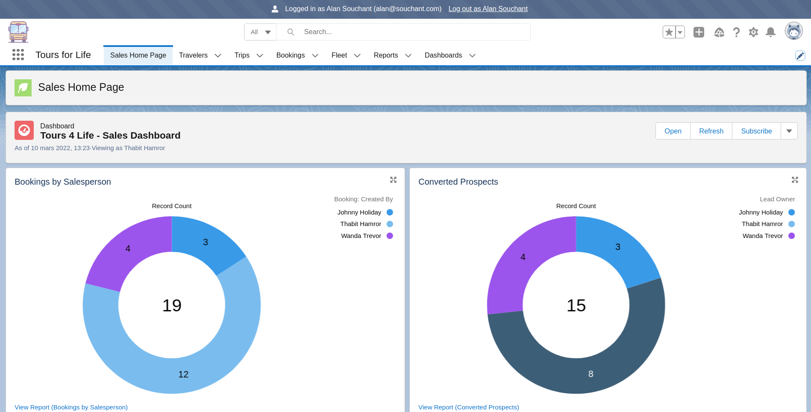
Dashboards : Sales Manager view

Slide 7
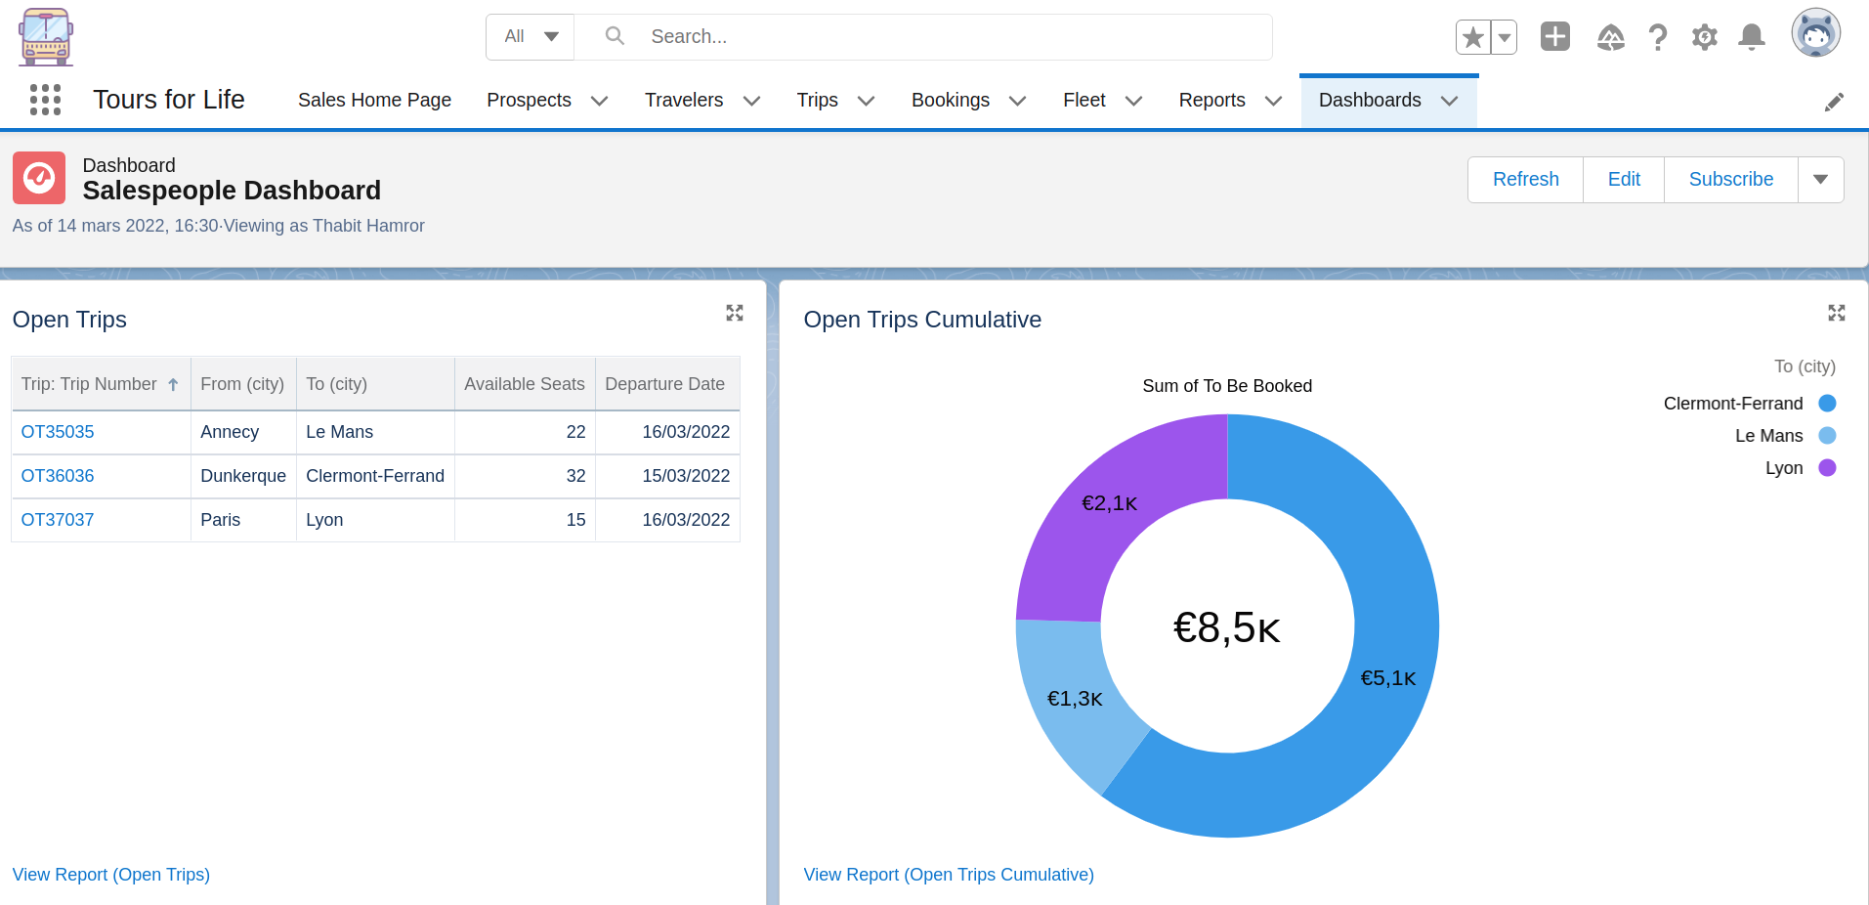
Dashboards : Sales Rep view

Slide 8
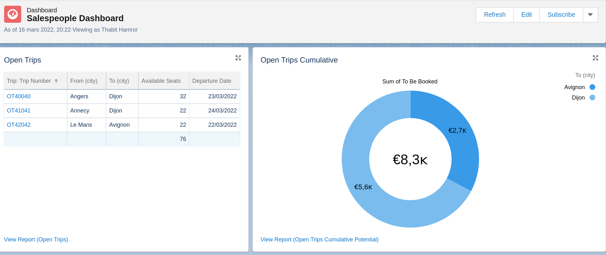
Dashboards : Sales Rep view

Slide 9
Components
Object | Implementation
Prospects | Renamed standard Lead object
Travelers | Renamed standard Account object
Trips | Custom Trip object
Purchased Trips | Booking custom and child object of Trips and Travelers
Bus (Fleet) | Child custom object of Trip

Slide 10
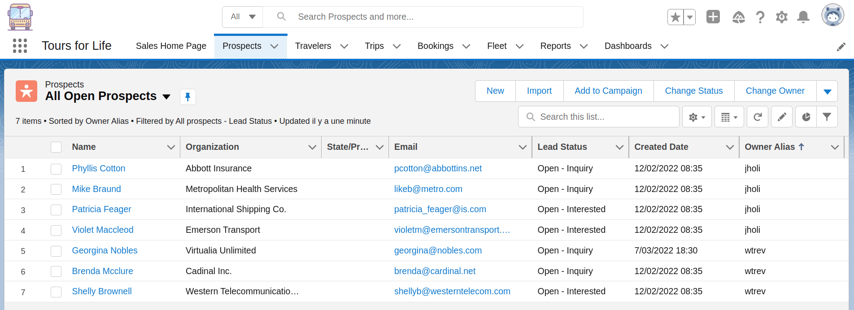
Prospects (Leads)

Slide 11
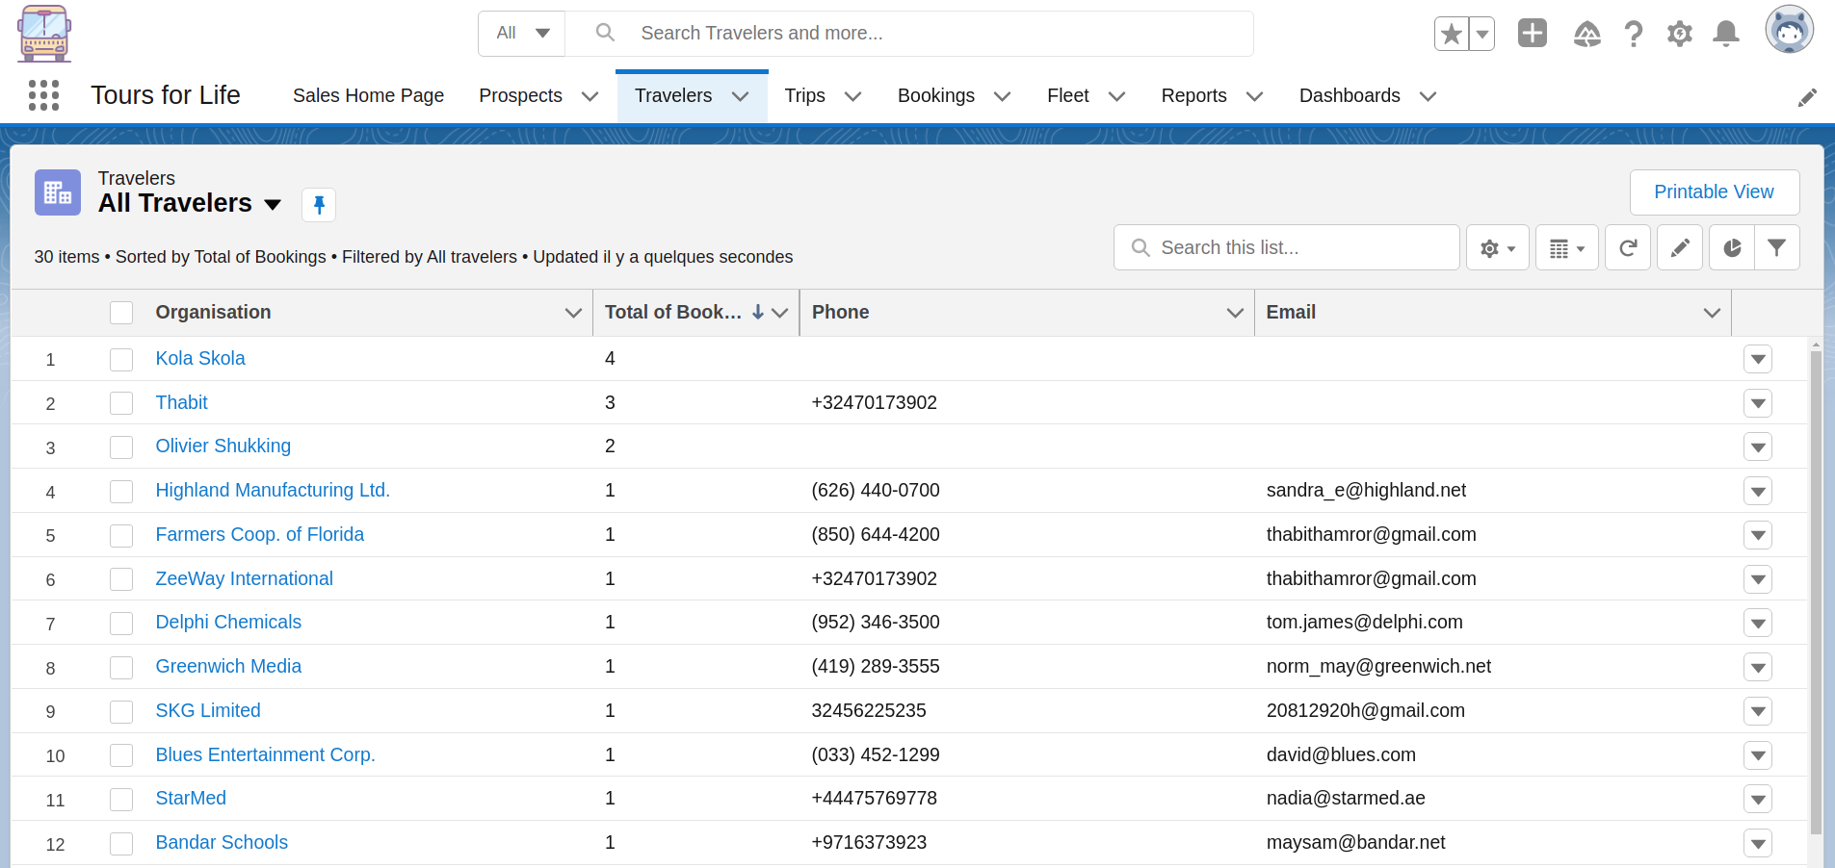
Travelers (Accounts)

Slide 12
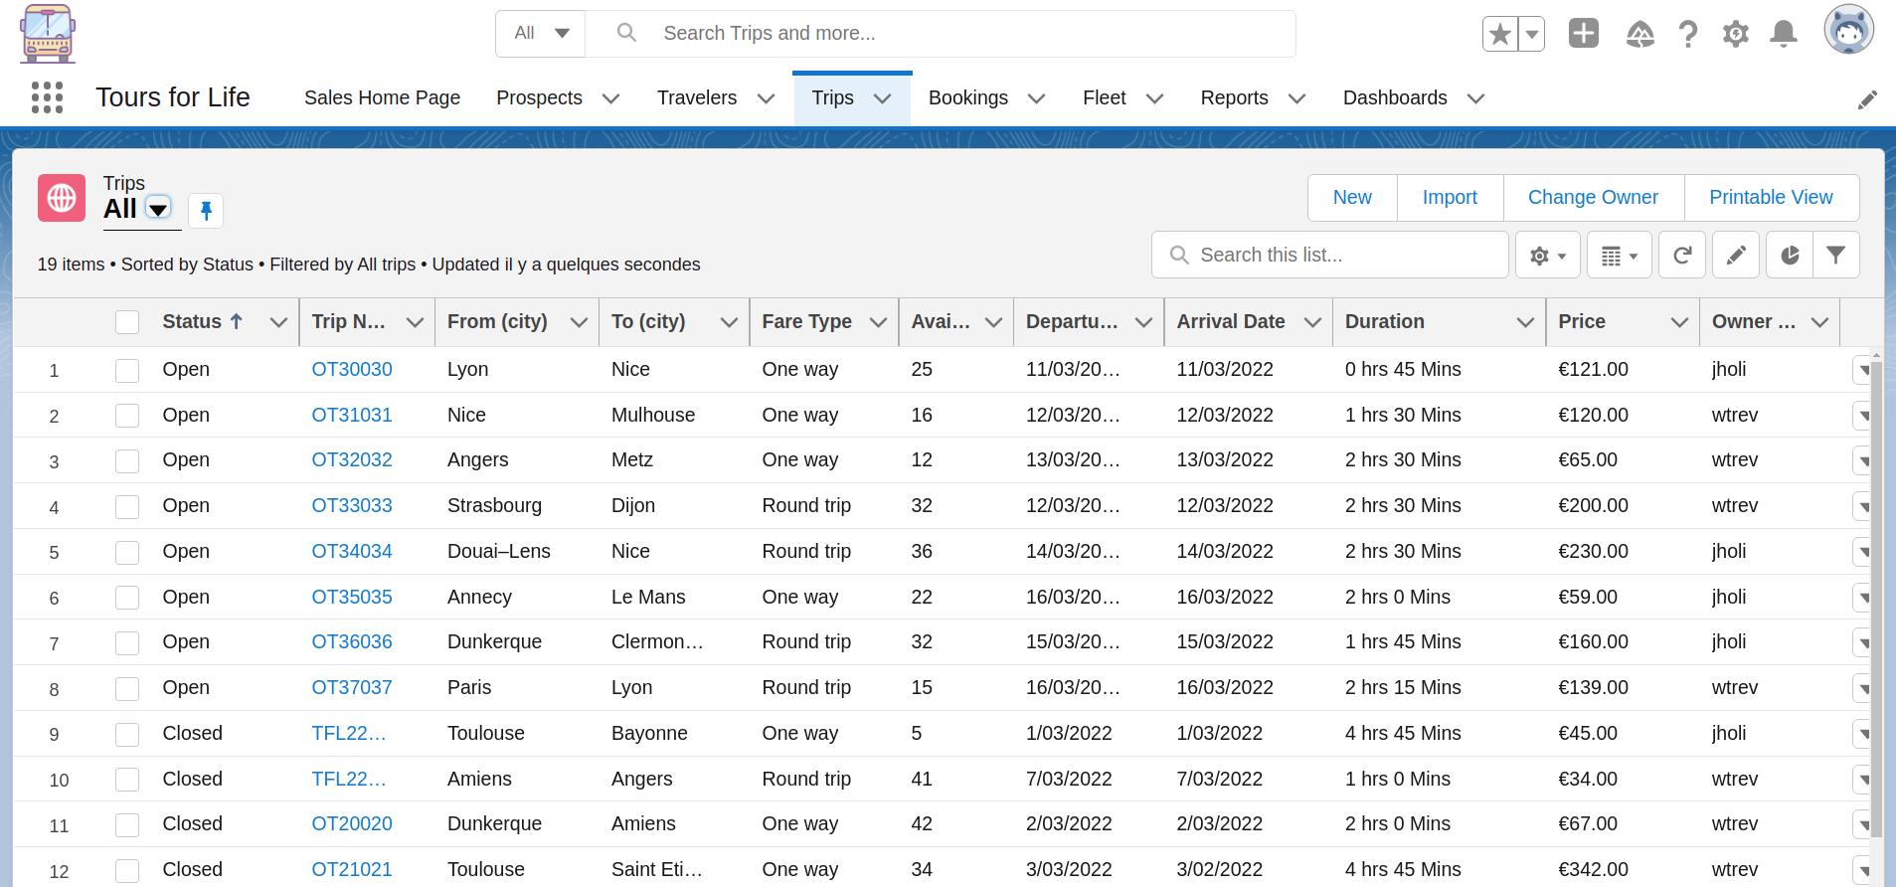
Trips

Slide 13
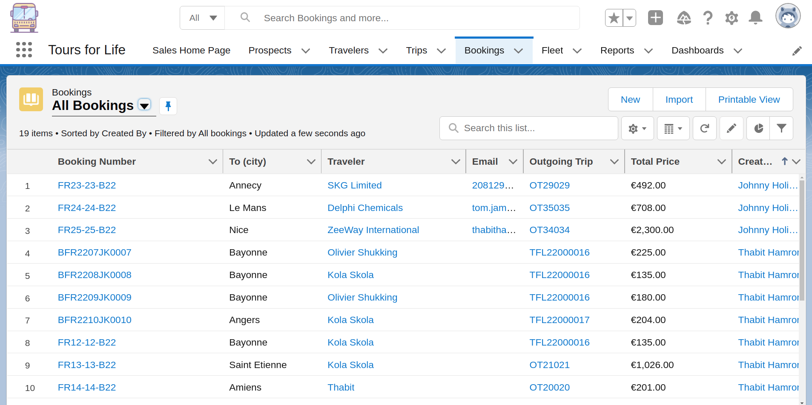
Bookings (Purchased trips)

Slide 14
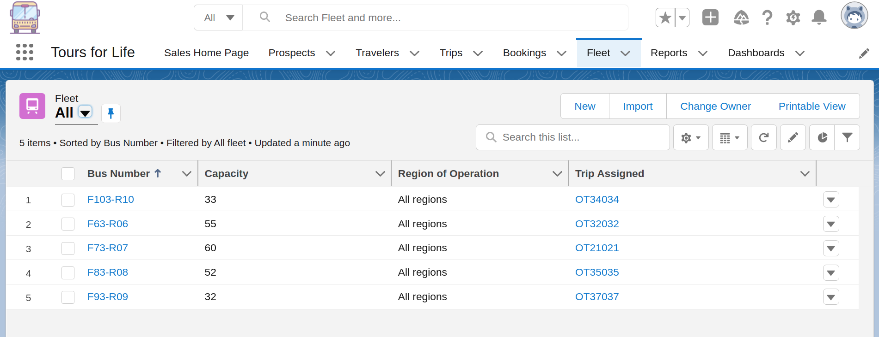
Bus (Fleet)

Slide 15
Automation
Requirement | Solution | Support
Update number of available places | Available places = Custom formula field | Seats Booked = Roll-Up summary custom field
Prospect status update email | Email action upon status change for prospect | Flow builder

Slide 16
Additional Automation
Requirement | Solution | Support
Bus assignment task | Bus assignment task assigned to manager once Trip is created | Process builder
Booking confirmation email | Email action upon status change for prospect | Flow builder
Trip status update | Close trip 3 hours before departure date | Workflow rules + flow builder

Slide 17
Mandatory fields
Object | Solution | Example
Standard | Validation rules | Phone and Email fields in the prospect object
Custom | Require check | Any field in the Trip object

Slide 18
Conclusion
Challenges:
Ambiguity in specifications regarding target clients
Open room for understanding the business needs (why email when prospect status changes? Can Traveler make zero bookings?)
Date – Time functions
Limitations:
No. of MD fields for Junction object
Profile licenses

Slide 19
Conclusion
Areas for improvement:
Consider individual clients option and move Fare Type to Booking
Move Bus assignment to Trip object (approve by sales manager if necessary)
Automating calculation of distance and duration of travel between cities
Learning:
Flow builder, process builder, workflow rules (for actions, tasks)
Search layouts
Working with Date – Time functions
Roles, hierarchies, profiles and licenses

Slide 20
Discussion / Debriefing

